Slide 1
Song Popularity Prediction and Genre Clustering with Spotify Data
Ray Efraim | JCDS Bandung Batch 2 | 2020

Slide 2

Self Introduction
Ray Efraim
Bachelor of Economics Maranatha Christian University
Data Analyst and Bandung Supply Coordinator 2018-2019

Slide 3

BACKGROUND
Producer/Label Side
Song Producing
Find out what creates a song popular in Spotify platform
Find out the chance of a song to be popular
Evaluate a plan or draft for a song before releasing it
Find new talents
Spotify Side
Genre
in Spotify, most songs’ genre are still in null value
Automatically labels existing and new song based
on their audio features

Slide 4
DATA GATHERING
 | danceability | energy | key | loudness | mode | speechiness | acousticness | instrumentalness | liveness | valence | tempo | duration_ms | time_signature | popularity | track_name | artist_name
1 | 0.896 | 0.586 | 10.0 | -6.687 | 0.0 | 0.0559 | 0.1040 | 0.000000 | 0.7900 | 0.642 | 116.971 | 196653.0 | 4.0 | 100 | The Box | Roddy Ricch
2 | 0.787 | 0.673 | 11.0 | -4.577 | 0.0 | 0.1580 | 0.2560 | 0.000004 | 0.0904 | 0.786 | 110.962 | 237893.0 | 4.0 | 97 | Say So | Doja Cat
3 | 0.831 | 0.499 | 11.0 | -8.442 | 0.0 | 0.1140 | 0.2690 | 0.000000 | 0.3000 | 0.511 | 97.956 | 220487.0 | 4.0 | 91 | High Fashion (feat. Mustard) | Roddy Ricch
4 | 0.794 | 0.793 | 11.0 | -4.521 | 0.0 | 0.0842 | 0.0125 | 0.000000 | 0.0952 | 0.677 | 123.941 | 183290.0 | 4.0 | 97 | Don't Start Now | Dua Lipa
5 | 0.695 | 0.762 | 0.0 | -3.497 | 1.0 | 0.0395 | 0.1920 | 0.002440 | 0.0863 | 0.553 | 120.042 | 215280.0 | 4.0 | 95 | Circles | Post Malone
Using Spotipy library to connect to the Spotify API
Limitation : 2000 tracks per year. Filter only by title/artist/album/year

Slide 5
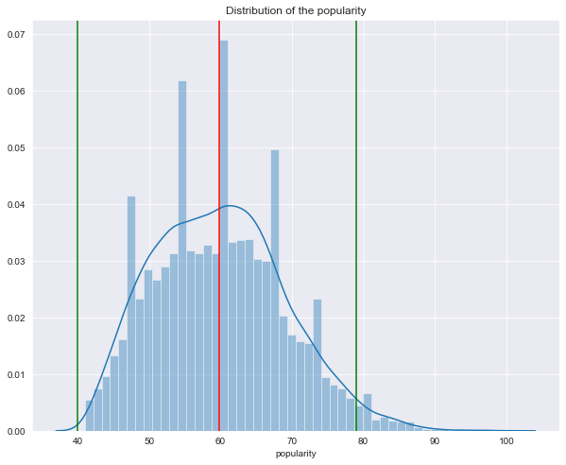
POPULARITY SCORE DISTRIBUTION

Slide 6
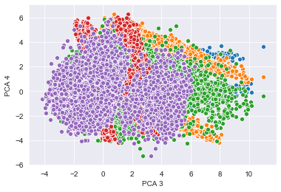
MACHINE LEARNING MODEL TO USE
Regression (Random Tree Regressor)
Clustering (KMeans)
Using density-based clustering method will not work since all the song actually make a big one cluster.
Model | MAE | RMSE | R2 Score
Linear Regression | 7.074 | 8.736 | 0.084
Lasso | 7.280 | 8.996 | 0.028
Ridge | 7.072 | 8.734 | 0.084
DecisionTreeRegressor | 9.402 | 11.890 | -0.698
RandomForestRegressor | 6.746 | 8.432 | 0.146
GradientBoostingRegressor | 6.800 | 8.438 | 0.144
XGBRegressor | 6.944 | 8.646 | 0.102
KNeighborsRegressor | 7.870 | 9.782 | -0.148

Slide 7
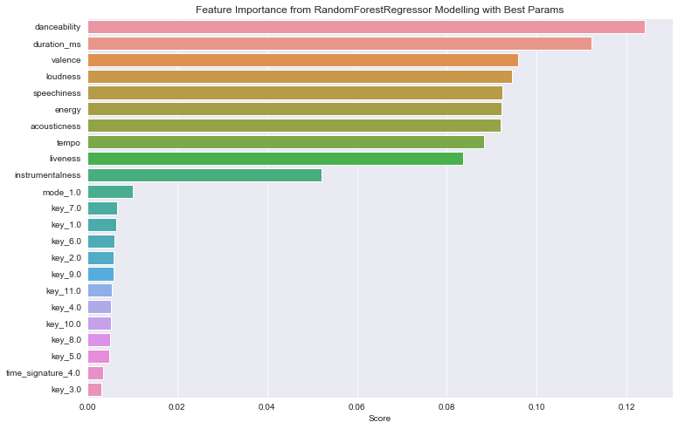
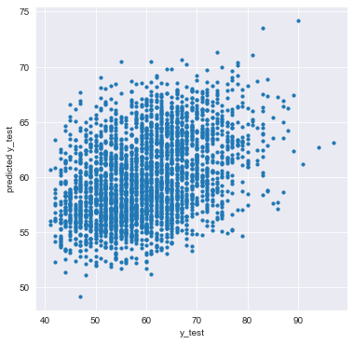
PREDICTING SONG POPULARITY SCORE
MAE : 6.75 %
RMSE : 8.41%
R2 Score : 15.56%

Slide 8
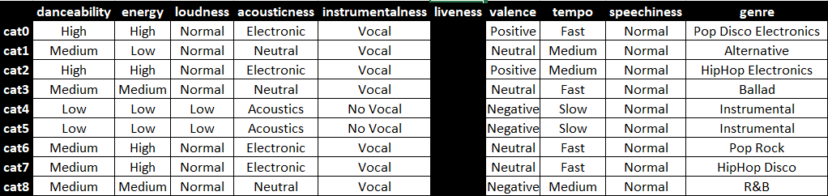
CLUSTERING SONG GENRE
Clustered to 9 Genre
Check outlier per cluster - > categorized every feature -> Manually listen and check the genre online for top 10 song per each cluster

Slide 9
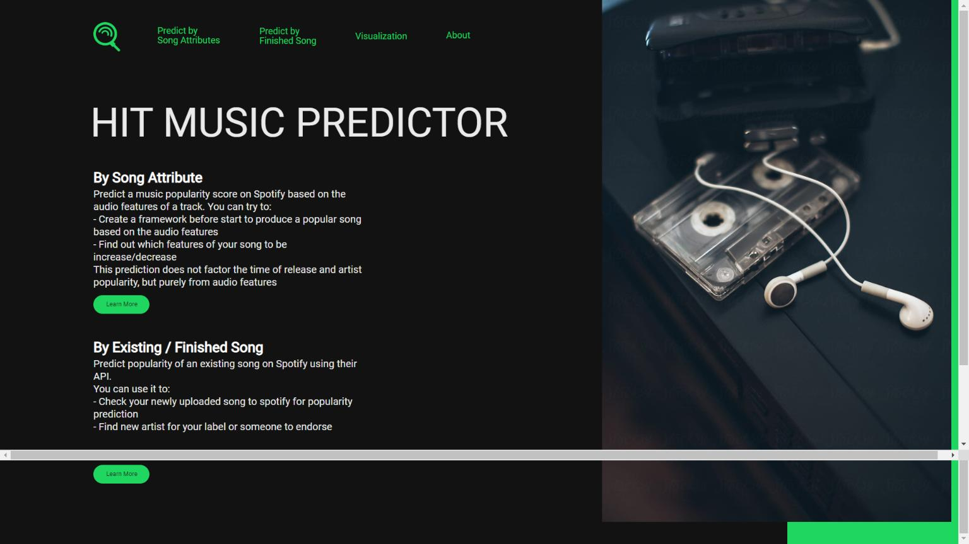
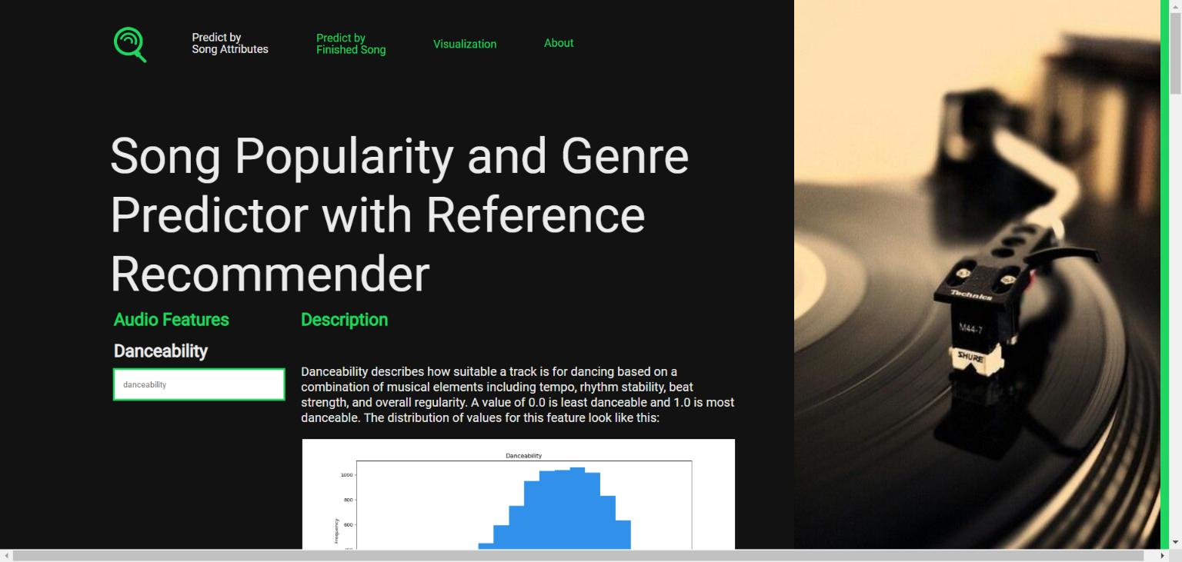
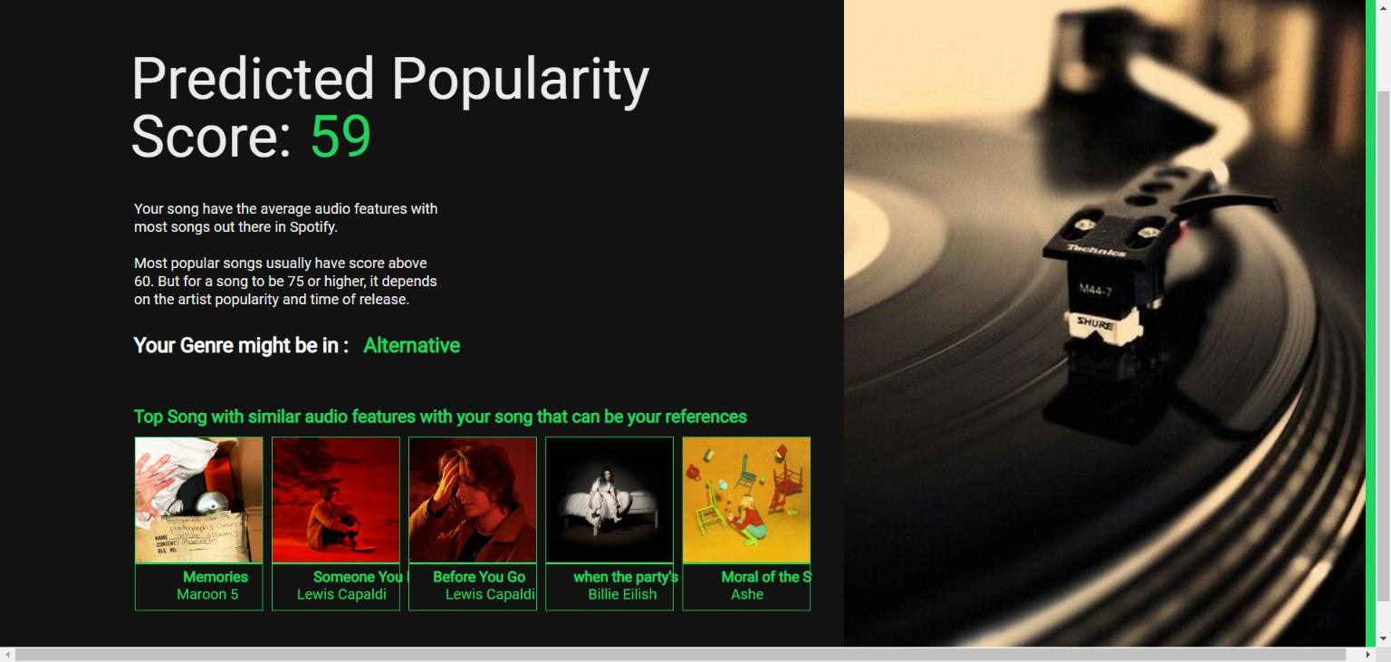
DASHBOARD
Homepage
Predict with Song Attributes
Result

Slide 10
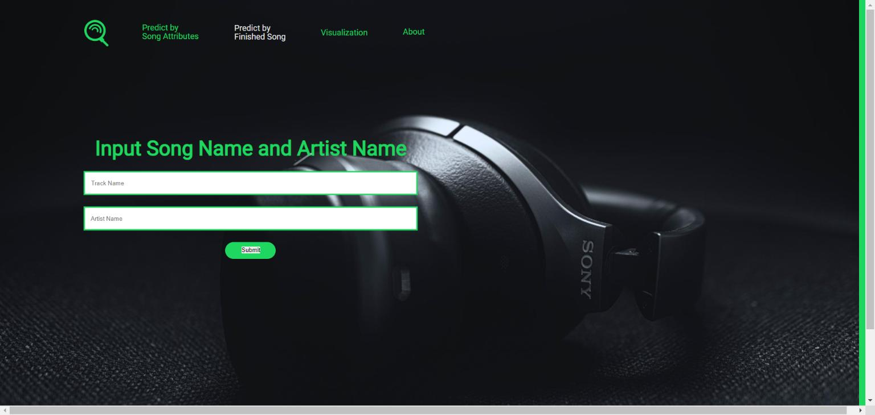
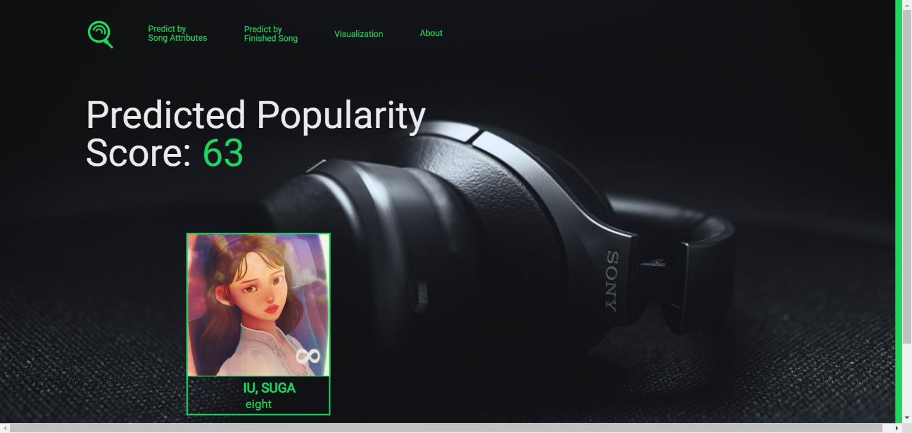
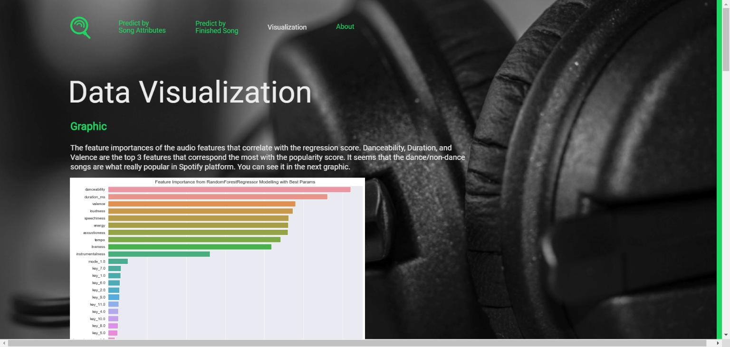
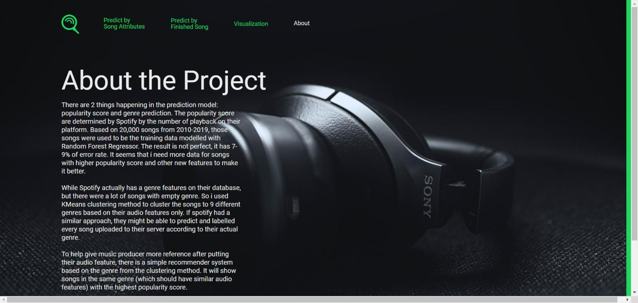
DASHBOARD
Predict from Spotify Library
Result
Data Visualization
About

Slide 11
CONCLUSION
Result
Popularity score prediction error rate is good enough to depict the song’s popularity
Clustering still need more tuning. Obviously there are more than 9 genre available. The clustering is already good enough from the manual sampling
What needs to be improved
Get additional new data with popularity score range from 7-100 (Might help)
Explore additional features

Slide 12
Song Popularity Prediction and Genre Clustering with Spotify Data
Ray Efraim | JCDS Bandung Batch 2 | 2020

